Slide 1


The Road to Spotify Wrapped 2023
Project 1

Slide 2

Spotify Wrapped
Every year Spotify release its data analysis regarding the most played, highest trending songs for the year

Slide 3
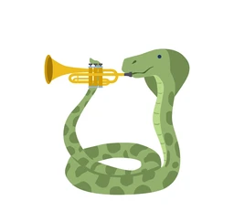

Our Clients
Our Clients – Penny Panda and Percy Python want to be in the Top 10 of Spotify Wrapped 2023 but have no idea how to get there!!

Slide 4
Spotify API
Data was collected from Spotify API. The focus of this was Top Tracks for 2012 – 2022. The playlists contain the following information:
a) Artist,
b) Album
c) Track_name
d) Track_id
e) Danceability
f) Energy
g) Key
h) Loudness
i) Mode
j) Speechiness
k) Instrumentalness
l) Liveness
m) Valence
n) Tempo
o) Duration_ms
p) Time_signature
We have then added the additional criteria: popularity, followers of the artists, genres, explicit lyrics and the year/ position the song featured in the list of the top tracks.
Final Data can be found at
https://github.com/hamdamoha/project1_spotify/blob/main/Final_Data_2012_2022.csv

Slide 5
Created a Spotify Developer account to get a Client ID and a Secret ID to acess the API
Created a Client which will generate tokens using the Spotify IDs which will allow acess to the API
Created a Client which will extract the information of a specific playlist
Researched the best playlists to provide the information we wanted to analyse
Extracted the relevent play lists data
Extracted additional information relating to each song on the play lists and added to the inital extract
Extracted additional information for each artists on the play lists and added to the play lists data frame
Added a label which showed which year the tracks were from and the poistion there were in each list
Mereged each play list into a final data frame
Code can be found in - https://github.com/hamdamoha/project1_spotify/blob/main/Spotify%20Extraction/Spotify_extraction.ipynb

Slide 6
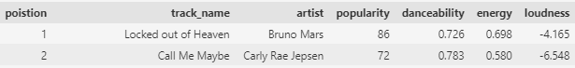
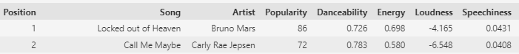
Clean up Examples
Renaming and reformatting
renamed_df = clean_df.rename(columns={"poistion":"Position", "track_name":"Song", "artist":"Artist", "popularity":"Popularity","danceability":"Danceability", "energy":"Energy", "loudness":"Loudness", "speechiness":"Speechiness", "instrumentalness":"Instrumentalness", "liveness":"Liveness", "valence":"Valence", "album": "Album", "year":"Year"})
renamed_df
Before
After

Slide 7
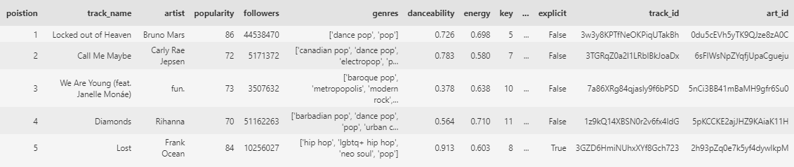
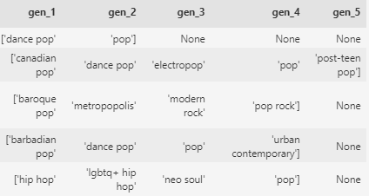
Clean up Examples
Editing Genre
Each track has multiple genres and was not extracted in a usable format
The split formula was used to put each of these into their own column in a data frame
df_split = df["genres"].str.split(",", n = 5, expand = True)
df["gen_1"] = df_split[0]
df["gen_2"] = df_split[1]
df["gen_3"] = df_split[2]
df["gen_4"] = df_split[3]
df["gen_5"] = df_split[4]

Slide 8
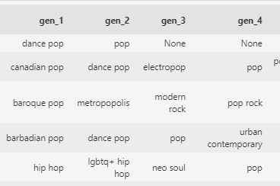
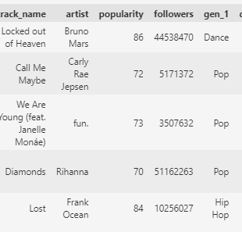
Clean up Examples
Editing Genre (count)
df["gen_1"] = df["gen_1"].str.replace("\['","")
df["gen_1"] = df["gen_1"].str.replace("\']","")
df["gen_1"] = df["gen_1"].str.replace("\'","")
df["gen_1"] = df["gen_1"].str.replace("\[]","None")
df["gen_1"] = df.gen_1.str.replace(r'(^.*dance.*$)', 'Dance’)
df["gen_1"] = df.gen_1.str.replace(r'(^.*alt.*$)', 'EDM')
df["gen_1"] = df.gen_1.str.replace(r'(^.*psych.*$)', 'Indie')
df["gen_1"] = df.gen_1.str.replace(r'(^.*comic.*$)', 'Pop')
The code can be found here
https://github.com/hamdamoha/project1_spotify/blob/main/Spotify%20Extraction/Data_cleaning.ipynb

Slide 9
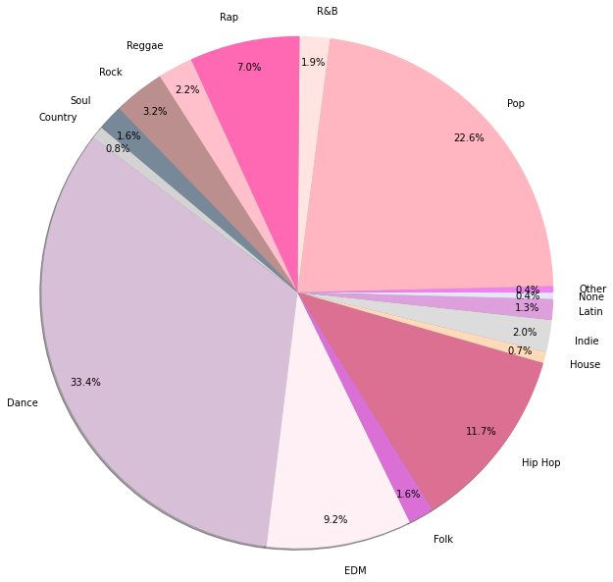
Genre
When looking at the genre over the last 10 years we can see that the most popular categories are
Dance
Electronic Dance Music
Hip Hop
Pop
Rap

Slide 10
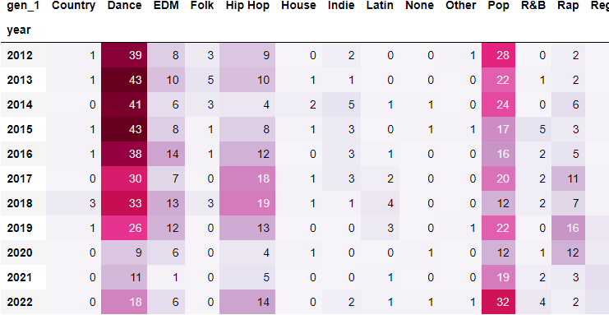
When we start to break this down by year, we can see that some of these genres have become less popular over time, and some are increasing in popularity

Slide 11
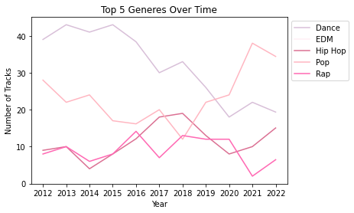
Dance music has become less prevalent over time, with Hip Hop and Pop increasing their share of the Top Tracks

Slide 12


Our First Recommendation
Pick either a Hip Hop or a Pop Genre for you hit song
Avoid Folk and Country music as they haven’t been represented at all in the Top Tracks for several years!

Slide 13

But What Else make a hit song….
Hypothesis 1: Recent years have a greater energy difference than later years.
Hypothesis 2: Speechiness does not influence the popularity of a song.
Hypothesis 3: There is a direct correlation between “energy” and “danceability” features.
Hypothesis 4: The number of followers an artist has an impact on their position in the top 50 (2022 only)

Slide 14

Hypothesis 1: Recent years have a greater energy difference than later years.
Pricilla

Slide 15
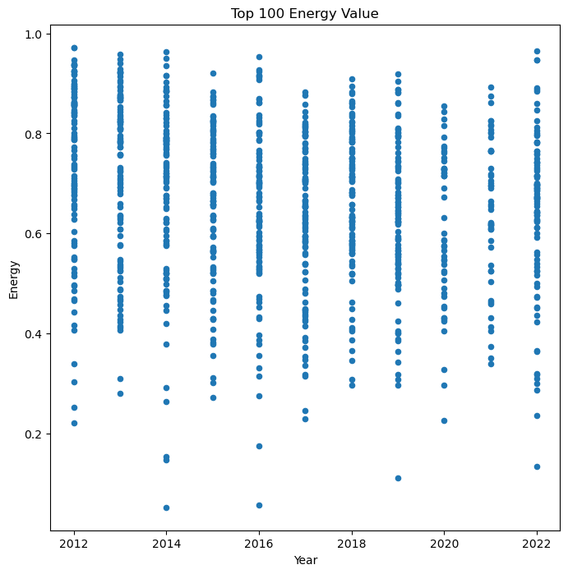
Energy Distribution
This shows a wide spread of energy values across each year.
There is minimal correlation

Slide 16
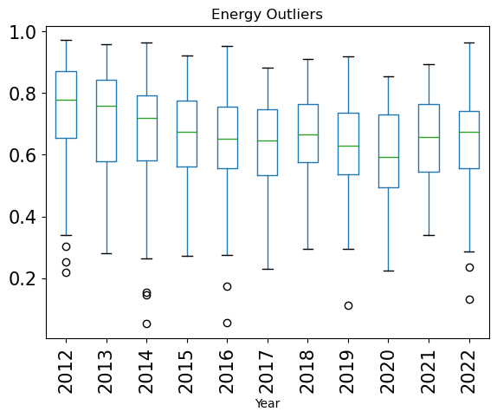
In the outliers graph, we can see that there is a high variability of the energy values and all the outliers are lower values. The averages from the last 10 years range from 0.609460 to 0.736550.
Outliers Graph

Slide 17
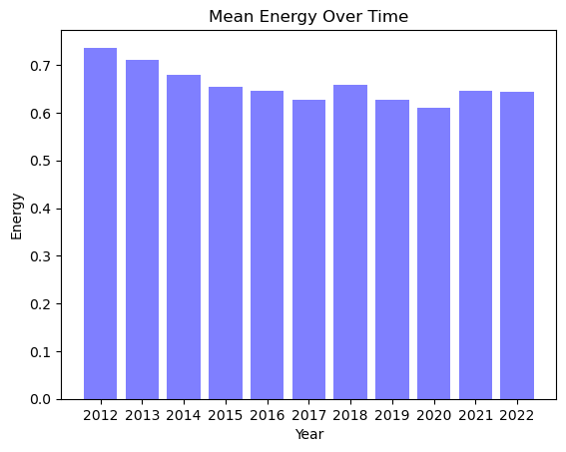
Energy Rating over time
The bar chart shows graphically the averages of the last 10 years.
It shows that the average of the energy value of the songs in the top 100 in the last years is lower than it was in 2012.
In 2020, the average reached its lowest value

Slide 18
Energy Conclusion
Conclusion
Recommendation
The energy value is not related to a song’s popularity.
In the top 100 over the years we can find songs with high and low values of energy.
Over the last 10 years, the average of the energy value of the songs decreased.
In 2020, the average of the energy value of the top 100 was the lowest and the max value was also the lowest on the last 10 years.
If our clients want to place their song on the top 100 should aim to create a song with an energy value of at least 0.60

Slide 19

Hypothesis 2: Speechiness does not influence the popularity of a song.
Lucie

Slide 20


What is Speechiness?
Speechiness - The higher the value the more spoken word the song contains
The song with the highest speechiness was Yes Indeed
by Lil Baby in 2018 at No.14
The song with the lowest speechiness was Perfect
by Ed Sheeran in 2017 at No.10
https://open.spotify.com/track/6vN77lE9LK6HP2DewaN6HZ
https://open.spotify.com/track/0tgVpDi06FyKpA1z0VMD4v?si=556be056e14e48c6

Slide 21
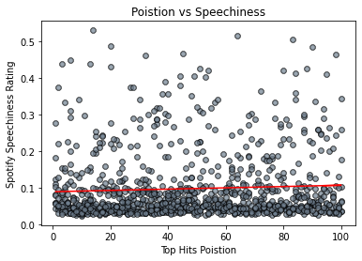
Speechiness Correlation
The r-value is: 0.003053302093949737
The correlation between both factors is 0.06
There is a very low correlation between the two factors

Slide 22
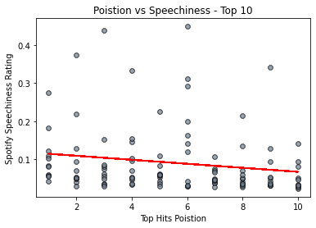
Speechiness Correlation – Top 10
The r-value is: 0.030076461345042268
The correlation between both factors is -0.17
When only looking at the top 10 songs the r value is higher but still doesn’t show any meaningful correlation
There is some evidence suggesting there is a minor negative correlation

Slide 23
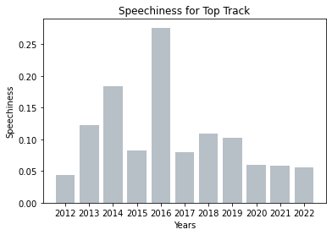
Speechiness over time
Speechiness has been decreasing over the last 5 years
There was a peak in 2016 but the value in 2022 was 0.05
The last 3 years have shown a low Mean Speechiness suggesting that the more popular songs in those years did not include a high proportion of spoken word.

Slide 24
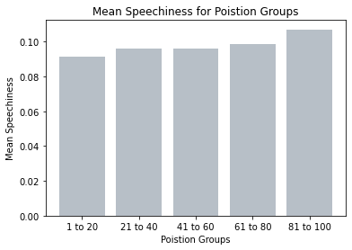
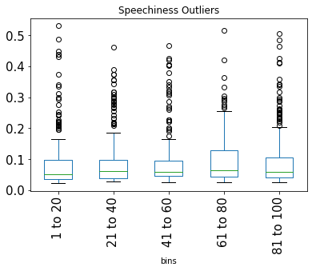
More on Speechiness
Speechiness is lowest on the 1 to 20 top tracks than 81-100 tracks
However, there are lots of outliers for each bracket, so this is not a good use of the data to draw conclusions.

Slide 25
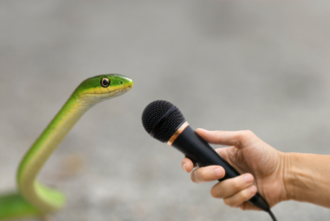
Conclusion:
Speechiness does have a minor effect on a songs popularity. Songs with lower speechiness appear more frequently in the Top Tracks, particularly over the last 3 years
Recommendation
Our Clients should create a song which has no more than a speeichniness value of 0.1 in order to increase their chances of getting their song into the Top Tracks of 2023

Slide 26

Hypothesis 3: There is a direct correlation between “energy” and “danceability” features.
Hamda

Slide 27
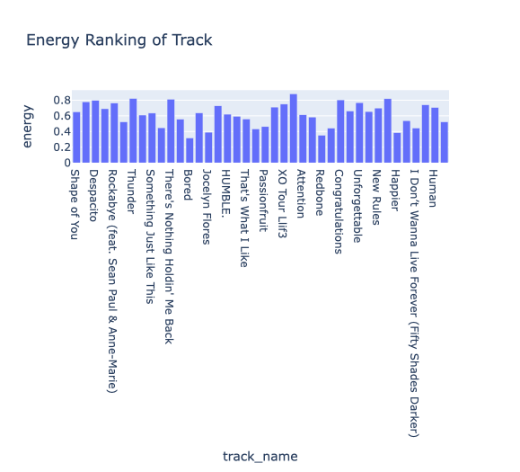
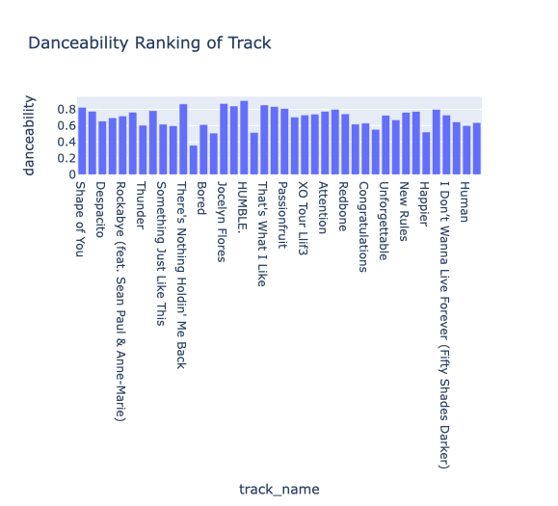
Danceability describes how suitable a track is for dancing based on a combination of musical elements including tempo, rhythm stability, beat strength, and overall regularity. A value of 0.0 is the least danceable and 1.0 is the most danceable.
Energy is a measure from 0.0 to 1.0 and represents a perceptual measure of intensity and activity

Slide 28
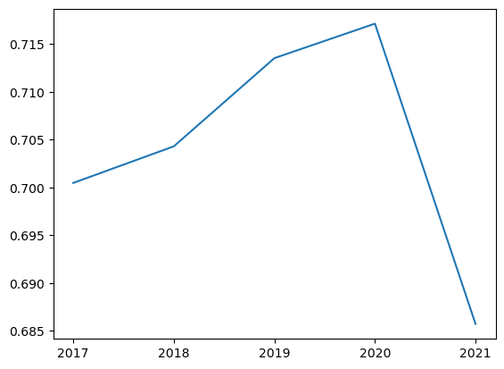
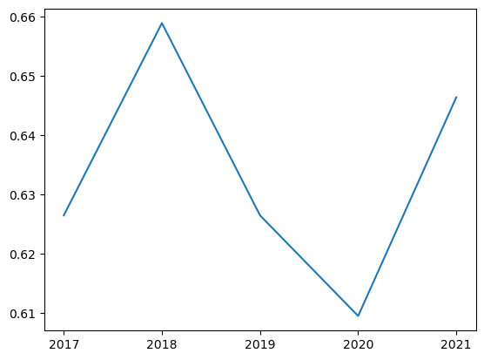
Judging from songs ranging from 75-95 score in popularity, 0.55-0.85 danceability seems to be the range in which popular songs fall into. Likewise, songs ranging from 85-95 score 0.5-0.85 energy are a suitable window to set the energy level.
Danceability mean over time
Energy mean over time

Slide 29
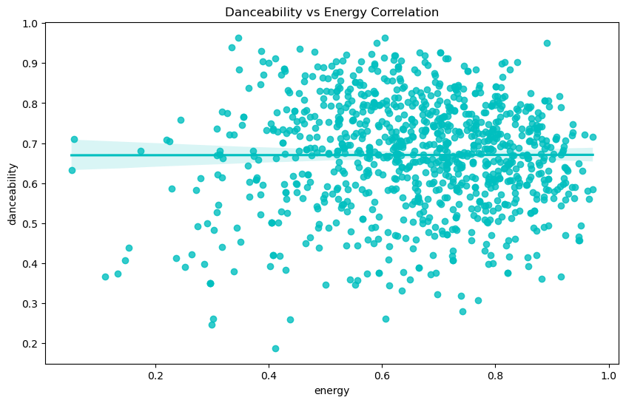
Danceability
Danceability and energy is trending higher by the year. Most of the data is clumping around the 0.55-0.85 which is consistent with the trend.
This trend is also confirmed by the data in 2021, the average energy level for a song is 0.646. Most of the top hits are falling between 0.5-0.85 in energy so this recommendation is still valid.

Slide 30

Conclusion: Danceability and energy are key factors that influence a song’s popularity.

Slide 31

Hypothesis 4: The number of followers an artist has an impact on their position in the top 50 (2022 only)
Jade

Slide 32
Follower Figures
In 2022 the mean number of followers from the Top Tracks list was 27651945.12
In 2022 the maxmium number of followers from the Top Tracks list was 105492653.0
In 2022 the minimum number of followers from the Top Tracks list was 47047.0

Slide 33
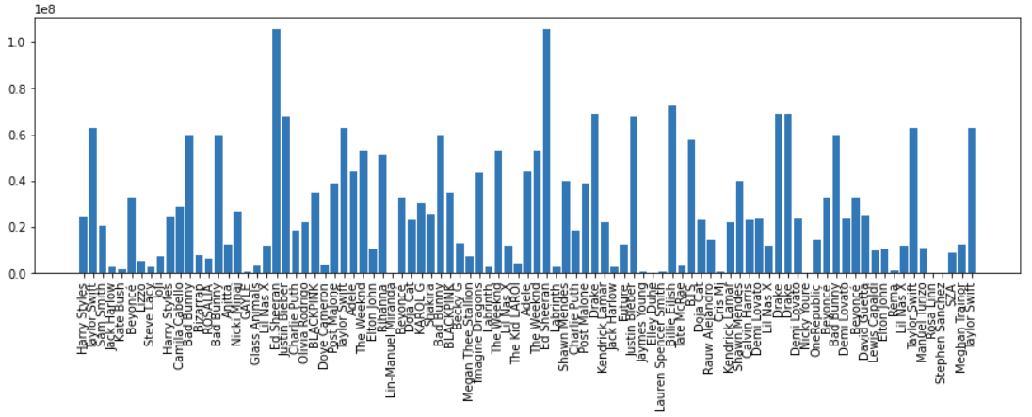
Overall Follower Figures 2022

Slide 34
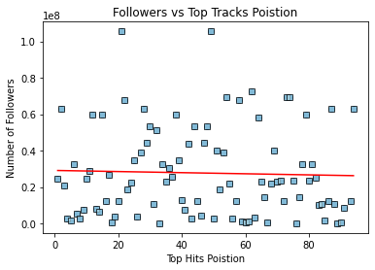
Followers Scatter Graph
The r-value is: 0.0011013978257632207
The correlation between both factors is -0.03

Slide 35

Conclusions
As you can see Harry Styles is number one and has 24543919 followers and Taylor Swift is second but has 62872493 followers. If you continue down the list you will see Ed Sheeran has the most followers but isn’t number one. So, there is no direct correlation between followers and chart position.
The song that is played the most is the biggest factor of the chart position.

Slide 36
Conclusions
If our clients want to place their song on the top 100 should aim to create a song with an energy value of at least 0.60
Our Clients should create a song which has no more than a speeichniness value of 0.1 in order to increase their chances of getting their song into the Top Tracks of 2023
Our client should use a range of 0.55-0.85 for danceability and 0.5-0.85 for energy
Our clients should aim for at least 50,000 followers to have a chance of making the list.

Slide 37
Projects Next Steps
Investigate all the features of Pop and Hip Hop songs to find more trends and patterns
Research other successful songs that meet our recommendations, e.g. a energy of above 0.6 with speechiness below 0.1, to look for other area’s which they have in common to generate more recommendations
Look at the common features of songs with artists who have a followers of above 1,500,000
Book some studio time for Penny Panda and Percy Python to start recording their masterpiece

Slide 38
Thank you for your time We will now take questions

Slide 39
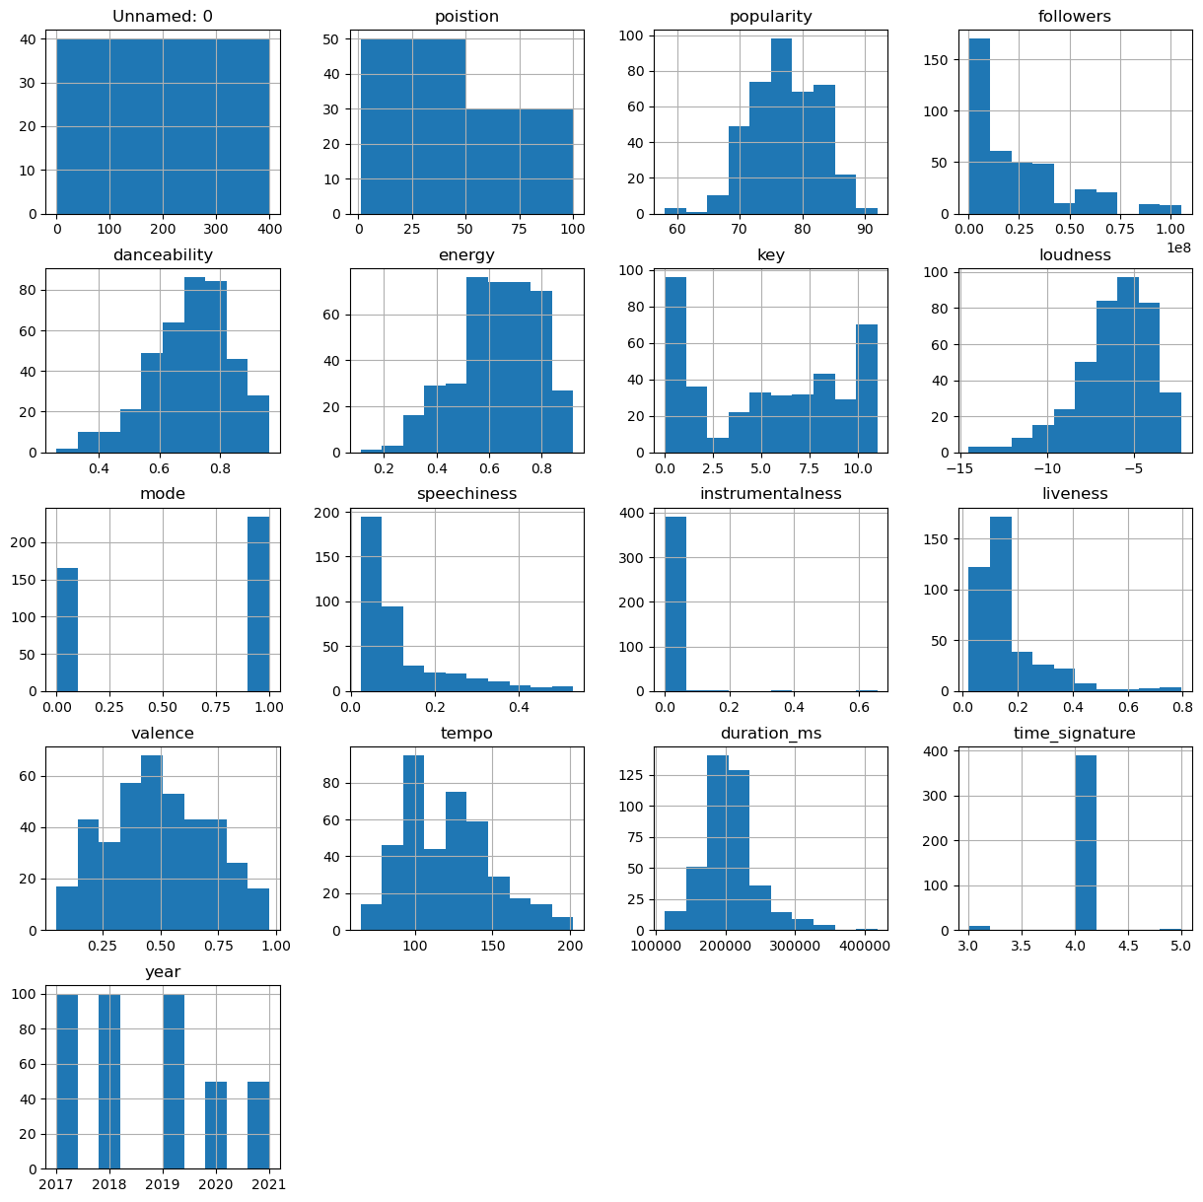
Supporting Information

